Slide 1
Big-O Notation,
Sets and Relations
Hubert Chan (Chapter 2.1, 2.2, 8)
[O1 Abstract Concepts]

Slide 2
Big O Notation
[O1 Abstract Concepts]

Slide 3
Big O Notation:
How fast is a function growing
Suppose that A, B, C, D are 4 programs. And the running times are 400log₂ n, 100n, 5n² and 2^{n} on input size n
What’s the running time for the following input size:
How fast a function grows is more important than the factors.
 | 400log₂ n | 100 n | 5n² | 2^{n}
2 | 400 | 200 | 20 | 4
16 | 1600 | 1600 | 1280 | 65536
1024 | 4000 | 10240 | 5242880 | NA

Slide 4
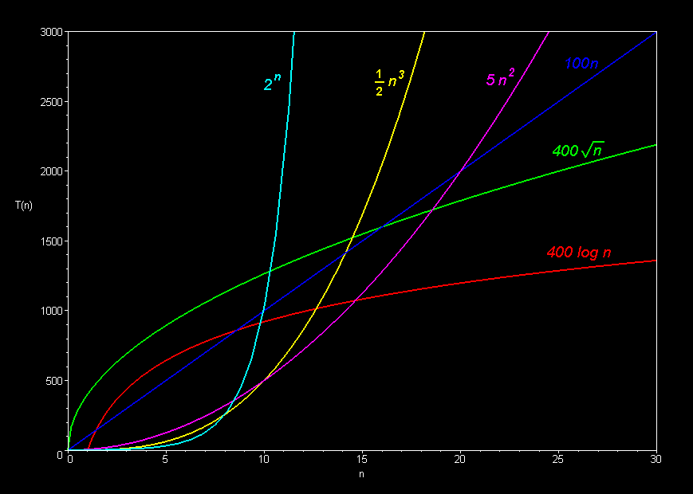

Slide 5
Complexity [O1]
Two functions T(n) and f(n) from Z⁺ to R⁺, then
T(n)=O(f(n)) if there exists a positive constant c and a positive integer N such that
  for all n ≥ N, T(n) ≤ c·f(n)
Example:
T(n)=10n+n²=O(n²)

Slide 6
Example
T(n)=10n+n²=O(n²)
Let N=10, c=2
For n ≥ N
T(n)=10n+n² ≤n²+n²=c·n²
More Examples:
  T(n)=2n²=O(n²), T(n)=2n²=O(n³)
  T(n)=3log₂n=O(log₂n), T(n)=3log₂n=O(n)
  T(n)=n+5log₂n=O(n)

Slide 7
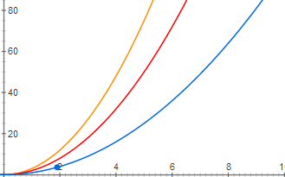
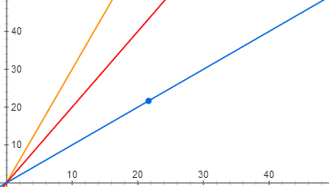
The meaning of c
Consider the following groups of functions:
  A: f(n)=n, f(n)=2n, f(n)=3n
  B: f(n)=n², f(n)=2n², f(n)=3n²
A: B:
The curves in the same group have the same shape up to scaling.
The curves in group A and the curves in group B are quite different.

Slide 8
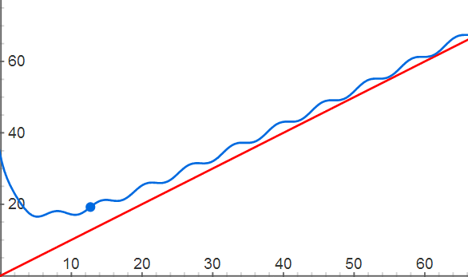

The meaning of N
Consider the following functions:
  $f\left(x\right)=\frac{100}{x+3}+\sin{x}+x$
  $g\left(x\right)=x$
It’s easy to see that when x gets large they are almost the same. But when x is small, they differ a lot.

Slide 9
More Examples
Define functions from Z⁺ to R⁺ such that
  f(n) = 10n
  g(n) = 2log₂n
  h(n) = 2n³ - n + 5log₂n
Then we have:
  f(n)=O(n)
  g(n)=O(log₂n)
  h(n)=O(n³)
  f(n)=O(n²)
  g(n)=O(n)
  h(n)=O(n⁴)

Slide 10
Complexity
T(n)=Ω(f(n))
  If there exists a positive constant c and a positive integer N such that for all n ≥ N, T(n) ≥ c·f(n).
  T(n)=Ω(f(n)) ↔ f(n)=O(T(n))
T(n)=Ɵ(f(n))
  if there exists two positive constant c₁, c₂ (c₁<c₂) and a positive integer N such that for all n ≥ N,
  c₁·f(n) ≤ T(n) ≤ c₂·f(n).
  T(n)=Ɵ(f(n)) ↔ ( T(n)= Ω(f(n)) ˄ T(n)=O(f(n)) )

Slide 11
Examples on Ω and £
Define functions from Z⁺ to R⁺ such that
  f(n) = 10n
  g(n) = 2log₂n
  h(n) = 2n³ - n + 5log₂n
Then we have:
  f(n)=Ω(n), f(n)=Ɵ(n)
  g(n)=Ω(log₂n), g(n)=Ɵ(log₂n)
  h(n)=Ω(n³), h(n)=Ɵ(n³)
  f(n)=Ω(log₂n)
  g(n)=Ω(log₂log₂n)
  h(n)=Ω(n)

Slide 12
Sets and Relations

Slide 13
Sets – Definition & Notation [O1]
A set is a collection of objects.
Example:
A = {apple, orange, mango, pear}
B = {policeman, fireman, manager, doctor, lawyer}
C = {1, 2}
D = {1, house, john, apple, salmon}
E = {1, 2, C} = {1, 2, {1, 2}}
F = {F, 1}

Slide 14
Elements of a Set
  The objects are called elements or members of the set.
  A set is said to contain its elements.
Notations:
  x ∈ S : x is an element of the set S.
    2 ∈ { 5, 7, π, “apple”, 2, 2.718 }
    {1} ∈ { {1}, {a, b}, a, 1 }
    Given F = {F, 1}, F ∈ F ?
  x ∉ S : x is not an element of the set S.
    apple ∉ { 5, 7, π, “apple”, 2, 2.718 }
    b ∉ { {1}, {a, b}, a, 1 }

Slide 15
The Empty Set & The Universal Set
The set that has no elements is called the empty set or the null set, and is denoted by { } or ∅.
  Note that mathematically, there is only one empty set.
A question: Is this, { ∅ } , the empty set?
  Answer: No, this is a set containing 1 element, the empty set.
A set with 1 element is called a singleton.
    e.g. { x }, { 1 }

Slide 16
Finite and Infinite Sets
S is a finite set:
  S contains exactly n elements (n ≥ 0)
  | S | is the cardinality or the size of S
  | S | = n
Example: A = {1, 2, 3}, | A | = ? B = {1, {2}, {3, 4}, 5}, | B | = ?
| ∅ | = ? | {∅} | = ? | {∅, {∅}} | = ?
S is an infinite set if S is not finite.

Slide 17
Examples of Infinite Sets
Ex: natural numbers (non-negative integers) N = {0, 1, 2, 3, …}
integers Z = {…, -2, -1, 0, 1, 2, …}
positive integers Z⁺ = { 1, 2, 3, … }
rational numbers Q = { p / q | p ∈ Z, q ∈ Z, q ≠ 0 }
real numbers R
How can a set be defined?
  by listing the elements in the set
  by properties (predicate),
  i.e., only those element x which predicate P(x) is true.
  e.g., E = {x ∈ N ⎪ x is even}; P(x) = x is even
  Set builder notation:
  { x | ….. } means the set of x such that …

Slide 18
Russell’s Paradox
  Note that not everything is well-defined as a set.
  Russell’s paradox:
    Consider the set S = { x | x is a set and x ∉ x }.
    Does S contain itself?
    If yes, what happens?
    If no, what happens?
  Similar paradox: The Barber paradox
    A town has only 1 male barber. A man in the town is shaved by the barber if and only if he does not shave himself.
  Let S(x) = set of people shaved by x
    So S(b) = { x | x ∉ S(x) } where b = the male barber
    Is b ∈ S(b),? i.e, Does b shave himself?

Slide 19

Subsets
  The set A is a subset of B if and only if every element of A is also an element of B.
  Notation: A ⊆ B
  How to prove A ⊆ B ?
    To show that ∀x ( x ∈ A → x ∈ B )
  For every set A, we have ∅ ⊆ A and A ⊆ A.
  If A is a subset of B, but A ≠ B, then we say that A is a proper subset of B. (logical formula?)
  Notation: A B
  How to prove A B ?
    To show that A ⊆ B and ∃x ( x ∈ B ∧ x ∉ A )

Slide 20
Equal Sets
Two sets are equal if they have the same elements.
Example:
  { 1, 3, 5 } and { 1, 3, 5 } are equal
  { 1, 3, 5 } and { 3, 5, 1 } are equal
  { 1, 3, 5 } and { 1, 2, 3 } are not equal
  R = { x | x is a real number} is not equal to N = { 0, 1, 2, 3, … }
A = B implies ∀x (( x ∈ A → x ∈ B ) ˄ ( x ∈ B → x ∈ A ))
Hence A = B iff (A ⊆ B ˄ B ⊆ A)

Slide 21
The Power Set
Given a set S, the power set of S is the set of all subsets of the set S.
  Notation: P(S) or 2^{S}.
Example: What is the power set of S = { 1, 2 } ?
Solution:
The elements of P(S) are ∅, {1}, {2}, and {1, 2}.
Hence, P(S) = { ∅, {1}, {2}, {1, 2} }.
Another example: P({a, b, c}) = {φ, {a}, {b}, {c}, {a,b}, {b,c}, {c,a}, {a,b,c}}
Question 1: P(∅) = ? P( { ∅ } ) = ?
Question 2: If |S| = n, then | P(S) | = ?

Slide 22
⎪P(S)⎪= 2^{⎪S⎪}
Theorem: If S_{n} = {x₁, …, x_{n}} then ⎪P(S_{n})⎪= 2^{n}
Proof:
Each element of S_{n} may appear or not appear in a subset of S_{n}. Hence there are 2 possibilities for each element.
Hence, ⎪P(S_{n})⎪= 2*2*…*2=2^{n}
x₁ x₂ x₃
0 0 0 = φ
0 1 0
1 0 0
1 1 0
0 0 1
0 1 1
1 0 1
1 1 1 = S

Slide 23
Set Operations
Venn Diagram
Union: A ∪ B contains all elements that are either in A or in B, or both.
A ∪ B = { x | x ∈ A ∨ x ∈ B }
Example: First year Computer courses
  CS = { CP, CPA, FCS, MO}
  CE = { CP, CPA, EM, MO, EC}
  CS ∪ CE = {CP, CPA, FCS, MO, EM, EC}
Intersection: A ∩ B contains those elements in both A and B.
A ∩ B = { x | x ∈ A ∧ x ∈ B }
Two sets A and B are said to be disjoint if A ∩ B = ∅
Example: CS ∩ CE = {CP, CPA, MO}
Difference: A − B contains those elements in A but not in B.
A − B = { x | x ∈ A ∧ x ∉ B }
Example: CS − CE = {FCS}; CE − CS = {EM, EC}
Complement: A is the complement of A w.r.t. a set U.
A = U − A = { x | x ∉ A }

Slide 24
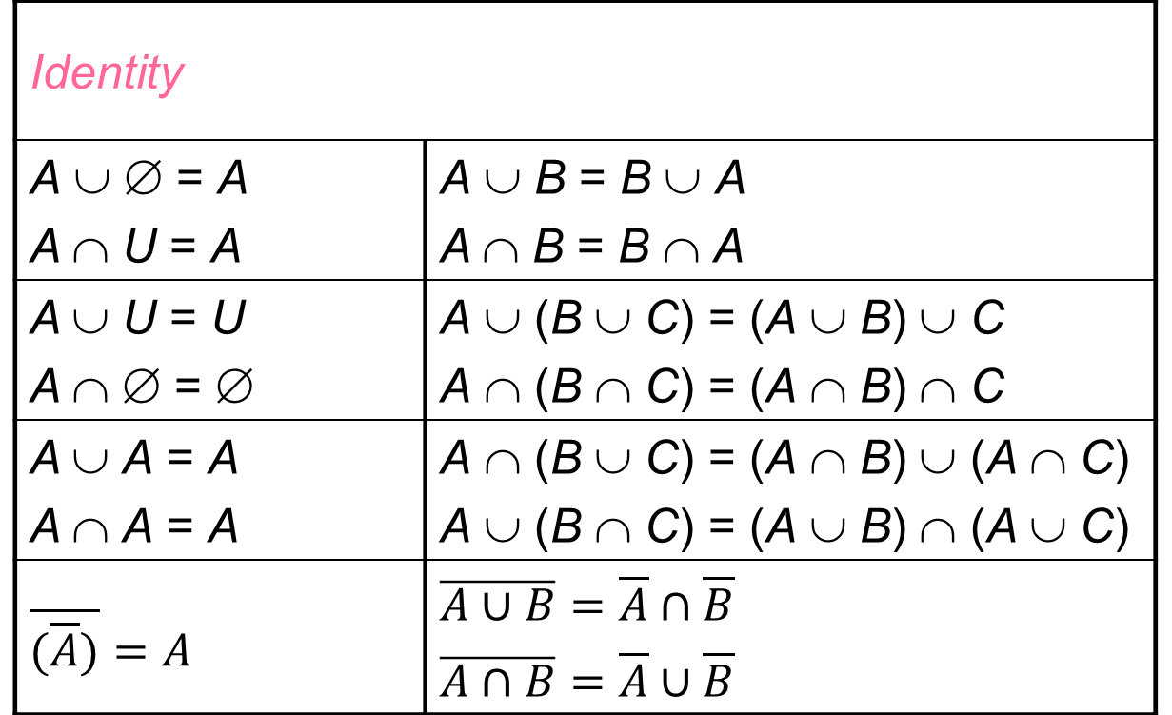
Set Identities
Identity
A ∪ ∅ = A A ∩ U = A | A ∪ B = B ∪ A A ∩ B = B ∩ A
A ∪ U = U A ∩ ∅ = ∅ | A ∪ (B ∪ C) = (A ∪ B) ∪ C A ∩ (B ∩ C) = (A ∩ B) ∩ C
A ∪ A = A A ∩ A = A | A ∩ (B ∪ C) = (A ∩ B) ∪ (A ∩ C) A ∪ (B ∩ C) = (A ∪ B) ∩ (A ∪ C)
$\overline{(\overline{A})}=A$ | $\overline{A∪B}=\overline{A}∩\overline{B}$ $\overline{A∩B}=\overline{A}∪\overline{B}$

Slide 25
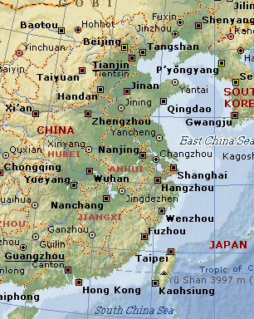
Relations
Consider C={HK, Beijing, Shanghai, Guangzhou, Nanjing}
Each city builds a road to the nearest city. This information (relationship among cities) can be represented by a set of 2-tuples (ordered pairs)
R = { (HK, Guangzhou), (Beijing, Nanjing),
(Shanghai, Nanjing), (Guangzhou, HK),
(Nanjing, Shanghai) }
(A,B) means A’s nearest city is B.
Ordered pairs are used to indicate
relationship between 2 objects.
Note that the ordering of the elements
are important!

Slide 26
Notation
Given a relation R on A, two elements a, b in A
  a R b iff (a, b) ∈ R
  a is said to be related to b by R
  e.g. A = { 1, 2, 3, 4 }. R = { (a, b) | a divides b }
  What are the elements of R?
R | 1 | 2 | 3 | 4
1 | √ | √ | √ | √
2 | × | √ | × | √
3 | × | × | √ | ×
4 | × | × | × | √
1
2
3
4
Table Representation
Graph Representation

Slide 27
Properties of Relations – Reflexive
A relation R on a set A is called reflexive
if (a,a) ∈ R for all a ∈ A.
I.e., ∀a ∈ A ((a,a) ∈ R )
Example:
  R = { (a, b) | a divides b }
  R = { (a,b) | a ≤ b } as a ≤ a
In contrasts, the following relations are not reflexive:
  “Parents” as a relation
  R = { (a, b) | a = b + 1 }
  R = { (a,b) | a < b }

Slide 28
Properties of Relations – Symmetric
A relation R on a set A is called symmetric
if (b,a) ∈ R whenever (a,b) ∈ R for all a,b ∈ A.
i.e. ∀ a,b ∈ A ((a,b) ∈ R → (b,a) ∈ R )
Example: (Symmetric)
  R = { (a,b) | a + b ≤ 3 }
  R = { (a,b) | a × b = 24 }

Slide 29
Properties of Relations – Transitive
A relation R on a set A is called transitive
if whenever (a,b) ∈ R and (b,c) ∈ R then (a,c) ∈ R for all a,b,c ∈ A.
i.e. ∀ a,b,c ∈ A (((a,b)∈R∧(b,c)∈R) → (a,c)∈R)
Example:
  R = { (a,b) | a > b }
  R = { (a,b) | a divides b }

Slide 30
Examples
1
Properties:
Reflexive?
Symmetric?
Transitive?
Does there exist a relation which has all these 3 properties?
2
3
4
1
2
4
3

Slide 31
Equivalence Relations
A relation on A is called an equivalence relation
if it is reflexive, symmetric and transitive.
Example:
  Suppose R is the relation on the set of people with the same family name
  a R b : a sits in the same row as b
    reflexive?
    symmetric?
    transitive?
    Is R an equivalence relation?

Slide 32
Equivalence Classes
Let R be an equivalence relation on a set A.
  The set of all elements that are related to an element
  a of A is called the equivalence class of a.
  [a]_{R} = { s | (a, s) ∈ R }
  The equivalence class of a w.r.t. R is denoted by [a]_{R}
  (or [a] if there is only 1 relation under consideration)
  Any element of an equivalence class is called a representative of the equivalence class.
b
[a] = {a}
a
e
[b] = {b,c,d} = [c] = [d]
d
[e] = [f] = {e,f}
f
c

Slide 33
Next Lecture: Countability
Z⁺ = {1,2,3…..}
E⁺ = {2,4,6,8,…}
Real numbers
They are all infinite sets, but have different kinds of infinity
Z⁺ and E⁺ are countable sets
Real numbers are uncountable
Real number contains “more” elements

